Slide 1
Automated Detection and Classification of NFRs
Li Yi
6.30

Slide 2
Outline
Background
Approach 1
Approach 2
Discussion

Slide 3
Background
NFRs specify a broad range of qualities
security, performance, extensibility, …
NFRs should be identified as early as possible
These qualities strongly affect decision making in architectural design
Problem: NFRs are scattered across documents
Requirements specifications are organized by FR
Many NFRs are documented across a range of elicitation activities: meeting, interview, …

Slide 4
Automated NFR Detection & Classification
Textual material in natural language
Requirements
Extracted Sentences
Classifier
…
Security
Performance
Usability
Functionality

Slide 5
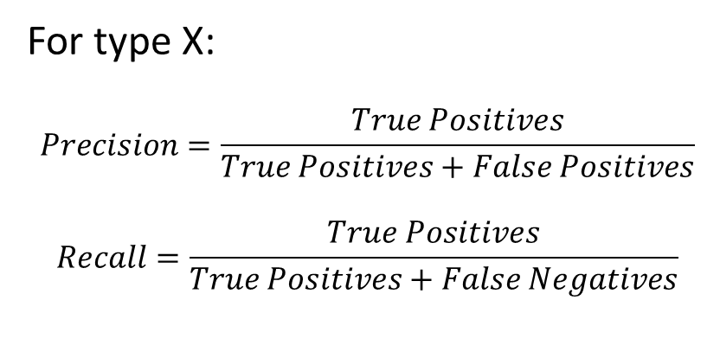
Evaluate the Classifier
 | Classified as Type X | Classified as Other Types
Actually belongs to Type X | True Positive | False Negative
Actually belongs to Other Types | False Positive | True Negative
For type X:
$$Precision=\frac{True Positives}{True Positives+False Positives}$$
$$Recall=\frac{True Positives}{True Positives+False Negatives}$$

Slide 6
Outline
Background
Approach 1
Approach 2
Discussion

Slide 7
Overview
Automated Classification of Non-Functional Requirements
J. Cleland-Huang et al., RE Journal, 2007
Strive for high recall (Detect as many as possible)
Evaluating candidate NFRs and reject false ones is much simpler than looking for misses in the entire document

Slide 8
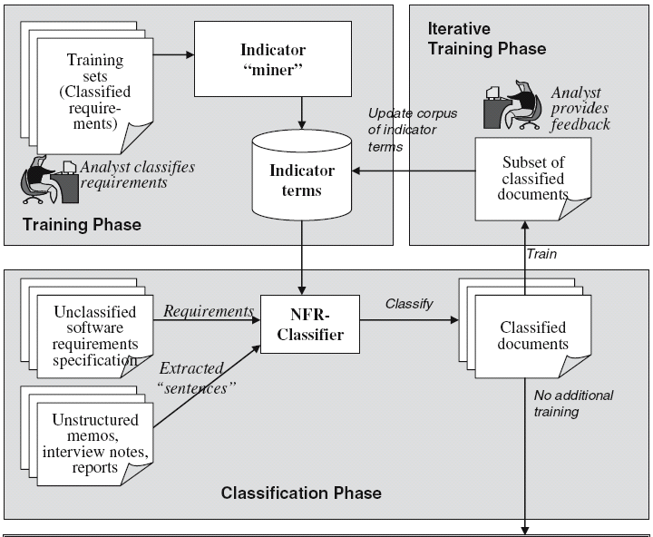
Process
Application Phase

Slide 9
Training Phase
Each requirements = A list of terms
Stop-words removal, term stemming
Pr_{Q}(t) = How strongly the term t represents the requirement type Q
Indicator terms for Q is the terms with highest Pr_{Q}(t)

Slide 10
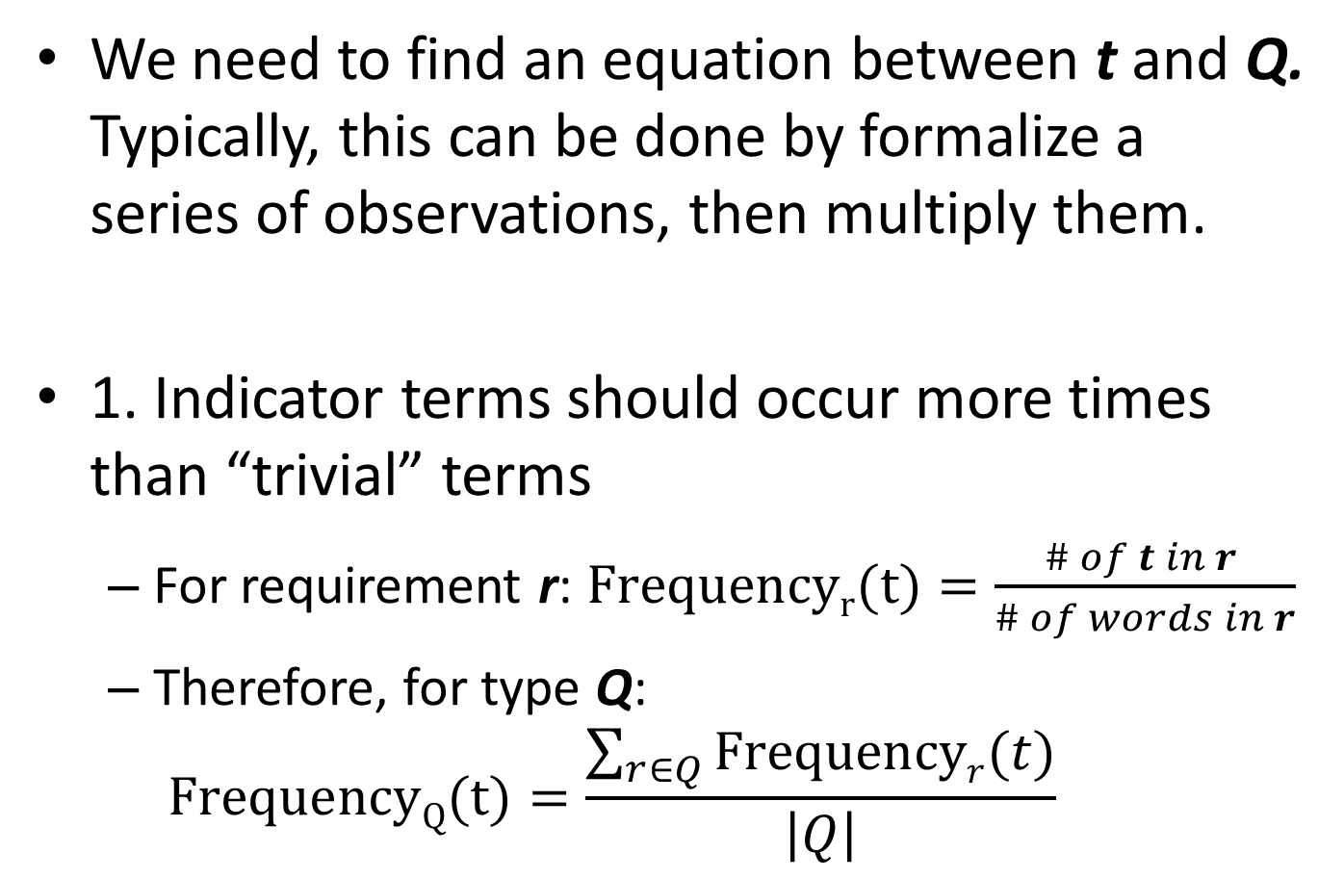
Compute the Indicator Strength: Pr_{Q}(t)
We need to find an equation between t and Q. Typically, this can be done by formalize a series of observations, then multiply them.
1. Indicator terms should occur more times than “trivial” terms
For requirement r: $Frequencyr(t)=\frac{\# of t in r }{\# of words in r}$
Therefore, for type Q: $FrequencyQ(t)=\frac{\sum_{r∈Q}{Frequencyr(t)}}{\left|Q\right|}$

Slide 11
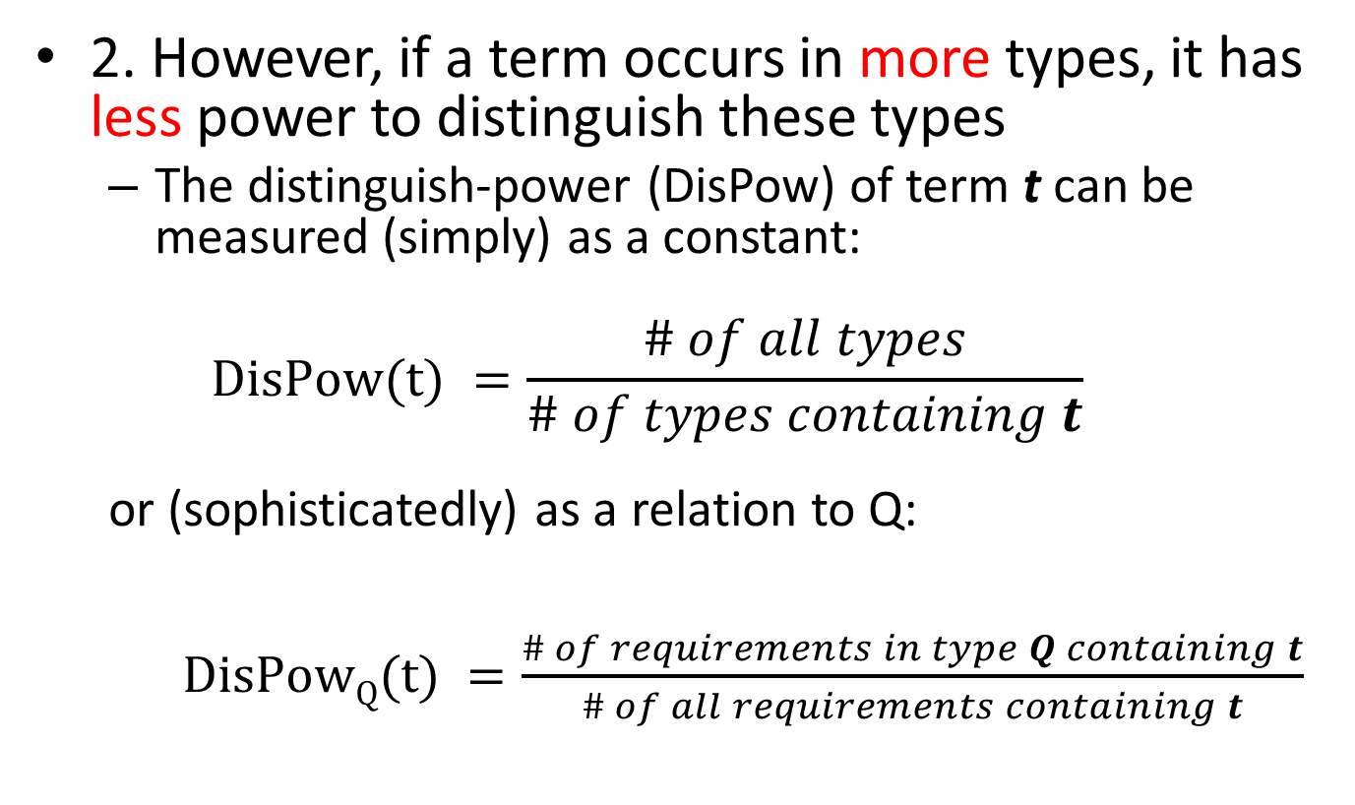
Compute the Indicator Strength: Pr_{Q}(t)
2. However, if a term occurs in more types, it has less power to distinguish these types
The distinguish-power (DisPow) of term t can be measured (simply) as a constant:
$$DisPow(t) =\frac{\# of all types}{\# of types containing t}$$ or (sophisticatedly) as a relation to Q: $DisPowQ(t) =\frac{\# of requirements in type Q containing t}{\# of all requirements containing t}$

Slide 12
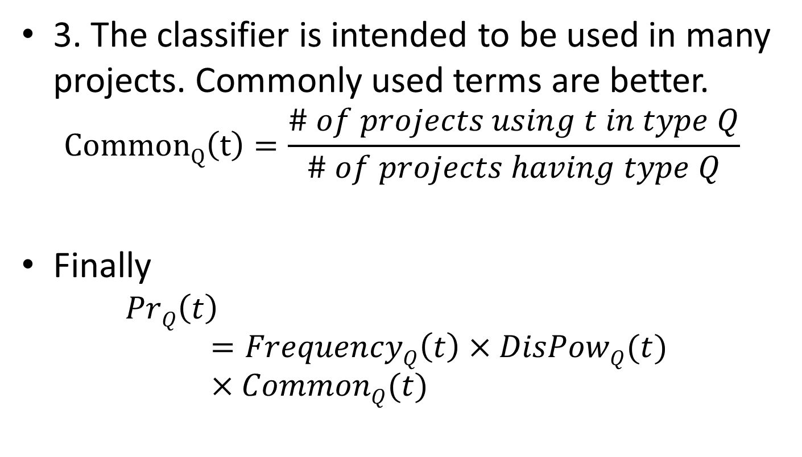
Compute the Indicator Strength: Pr_{Q}(t)
3. The classifier is intended to be used in many projects. Commonly used terms are better.
$$CommonQ\left(t\right)=\frac{\# of projects using t in type Q}{\# of projects having type Q}$$
Finally
$$PrQ\left(t\right)=FrequencyQ\left(t\right)×DisPowQ(t)×CommonQ(t)$$

Slide 13
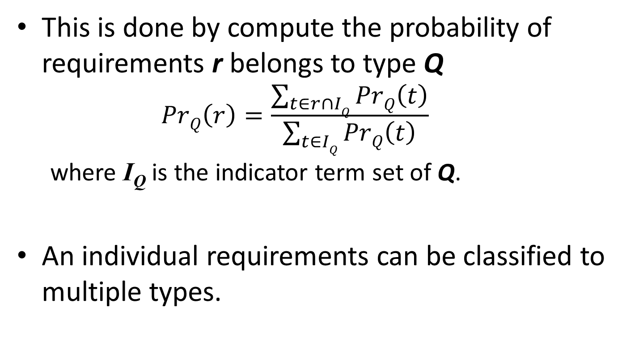
Classification Phase
This is done by compute the probability of requirements r belongs to type Q
$$PrQ\left(r\right)=\frac{\sum_{t∈r∩IQ}{PrQ\left(t\right)}}{\sum_{t∈IQ}{PrQ\left(t\right)}}$$
where I_{Q} is the indicator term set of Q.
An individual requirements can be classified to multiple types.

Slide 14
Experiment 1: Student’s Project
80% students have experience in industry
The data
15 projects, 326 NFRs, 358 FRs
9 NFR types
Avaiable at http://promisedata.org/?p=38

Slide 15
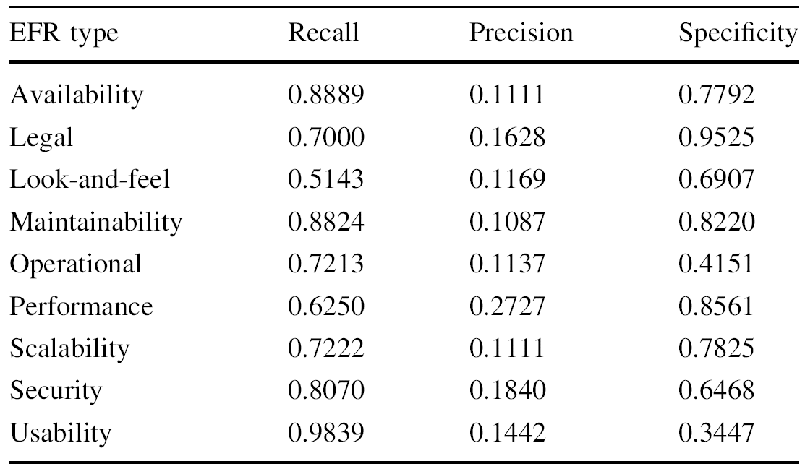
Experiment 1.1: Leave-one-out Validation
Result: choose top 15 as indicator terms, and classification threshold = 0.04

Slide 16
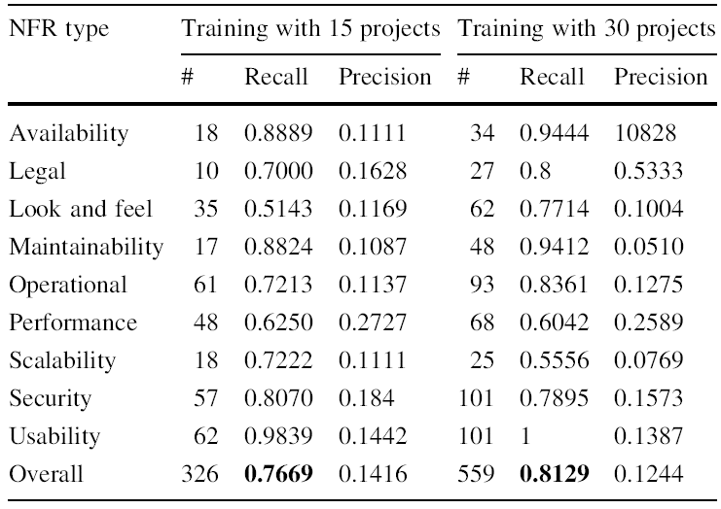
Experiment 1.2: Increase Training Set Size

Slide 17
Experiment 2: Industrial Case
A project in Siemens, and its domain is entirely unrelated to any of the 30 student projects.
The data
A requirement specification organized by FR. It contains 137 pages, 30374 words
Break it to 2064 sentences (requirements)
The authors took 20 hours to manually classify the requirements

Slide 18
Experiment 2.1: Old Knowledge vs. New Knowledge
A. The classifier is trained by previous student projects
B. The classifier is retrained by 30% of Siemens data
Result: Recall of most NFR types increase significantly (Precision is still low)

Slide 19
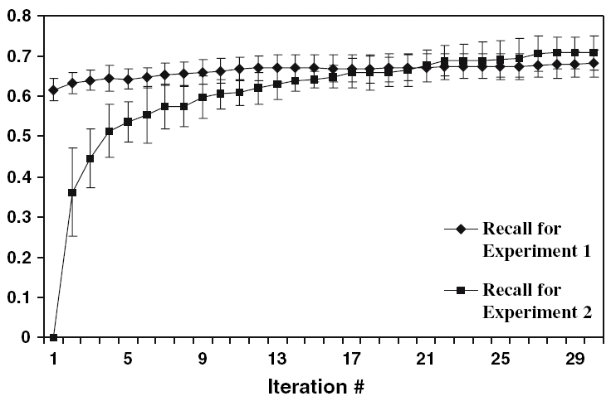
Experiment 2.2: Iterative Approach
In each iteration, 5 classified NFRs and top 15 unclassified requirements (near-classified) are displayed to analyst.
Near-classified requirements contains lots of potential indicator terms.
Has initial training set
No initial training set

Slide 20
Potential Drawbacks
The need of pre-classification on a subset of data when applied in a new project.
This can be labor-intensive, for example, a number of requirements must be classified for every NFR type
The low precision (<20%) may greatly increase the work load of human feedback
Consider experiment 1: Generally, analysts get 1 NFR after review 5 requirements; however, 50% of the requirements are NFRs ➔ Eventually analysts have to browse all requirements!

Slide 21
Outline
Background
Approach 1
Approach 2
Discussion

Slide 22
Overview
Identification of NFRs in textual specifications: A semi-supervised learning approach
A. Casamayor et al., Information and Software Technology, 2010
High precision (70%+), but relatively low recall
The process is almost the same as approach 1
“Semi-” reduces the need of pre-classified data

Slide 23
What’s Semi-Supervised
It means the training set = Few pre-classified data (P) + Many unclassified data (U)
The idea is simple
Train with P
Classify U
Train with P and classified U
Continue?
Y
N
Training is finished

Slide 24
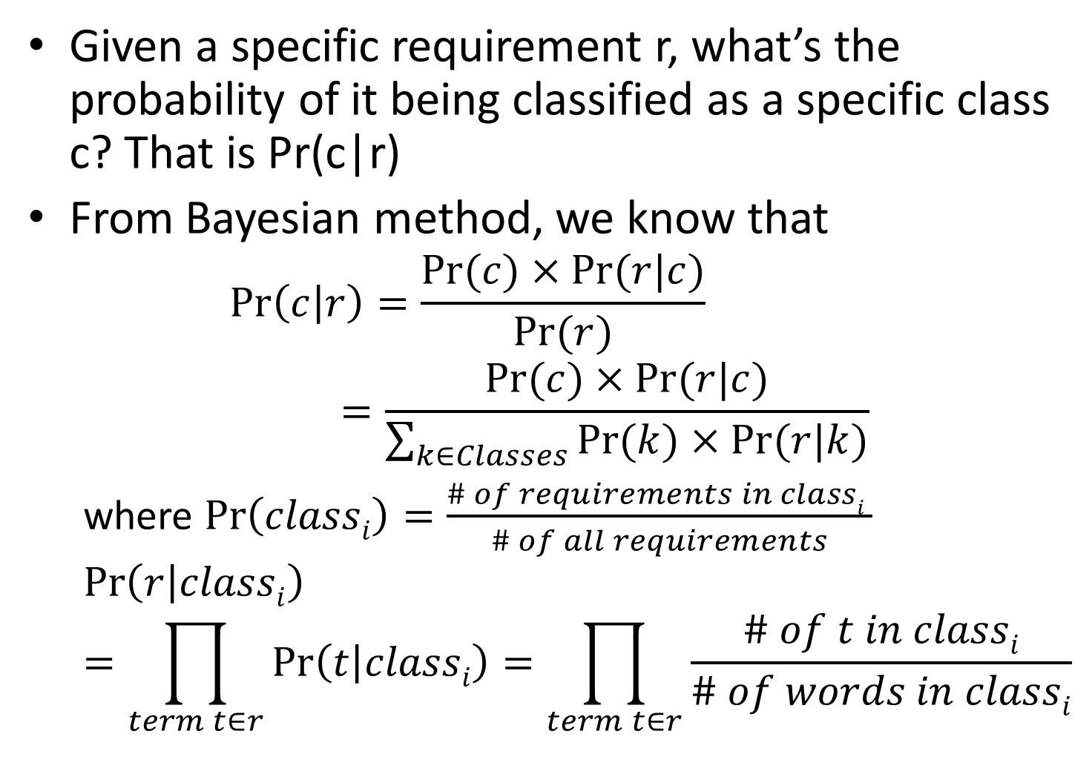
Training Phase: The Bayesian Method
Given a specific requirement r, what’s the probability of it being classified as a specific class c? That is Pr(c|r)
From Bayesian method, we know that
$$\operatorname{Pr}\left(c | r\right)=\frac{Pr⁡(c)×Pr⁡(r|c)}{Pr⁡(r)}=\frac{Pr⁡(c)×Pr⁡(r|c)}{\sum_{k∈Classes}{Pr⁡(k)×Pr⁡(r|k)}}$$
where $\operatorname{Pr}\left(classi\right)=\frac{\# of requirements in classi }{\# of all requirements}$
$$\operatorname{Pr}\left(r | classi\right)=\prod_{term t∈r}{\operatorname{Pr}\left(t | classi\right)=\prod_{term t∈r}{\frac{\# of t in classi}{\# of words in classi}}}$$

Slide 25
Classification Phase
Given an unclassified requirements u, calculate Pr(c|u) for every class c, and take the maximal one.

Slide 26
Experiments
The data is the same as the student projects in approach 1
468 requirements (75%) for training
Change the proportion of pre-classified ones
The rest (156) for testing
Also evaluate the effect of iteration

Slide 27
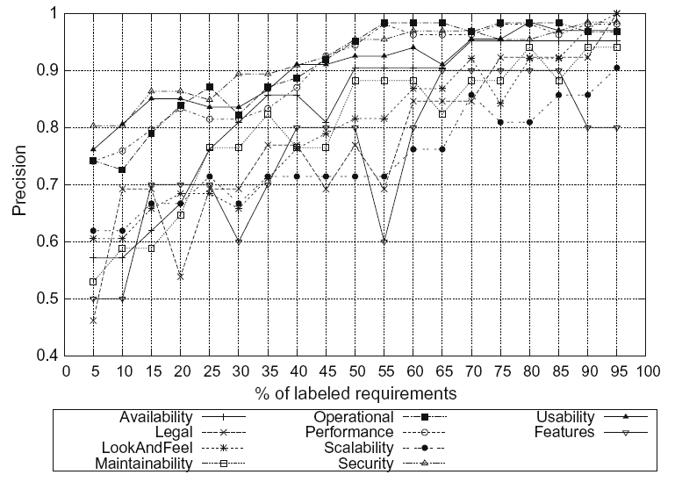
Results: No Iteration
When 30% (=0.75*0.4) of all requirements are pre-classified,
70%+ precision is achieved

Slide 28
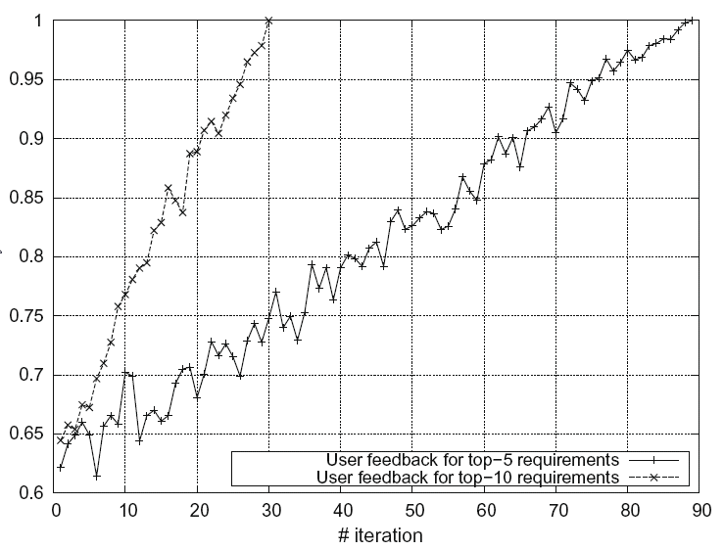
Results: With Iteration
Display top 10
Display top 5

Slide 29
Outline
Background
Approach 1
Approach 2
Discussion

Slide 30
Precision vs. Recall
Recall rate is crucial because a miss would give high penalty, in many scenarios (e.g. NFR detection, feature constraints detection.)
However, low precision rate significantly increases the work load of human feedback. Sometimes it means analysts may browse all data eventually.
A mixed approach might work:
First, use high-precision methods to find as many NFRs as possible
Then use high-recall methods on the rest data to capture the misses

Slide 31
An Open Question
Is there a perfect method in detecting NFRs (or even in requirements analysis)? If not, why?
In comparison, spam filters work perfectly
High precision: almost all detected spams are true
Extremely high recall: never miss
Why: almost all spams focus on specific topics such as “money”. If we generate spams as random text, I don’t believe that current filters still work perfectly.
But requirements documents contain considerable domain and project specific information
Furthermore, the design/code seems not so diverse as requirements, there may be perfect methods for them

Slide 32
THANK YOU!

